Slide 1
Pseudo Random Number Generator for cryptography
Presented by
Vadlamudi Girish
Varakala Yashwanth
Elaprolu Sahithi
Jitendra Balwada

Slide 2

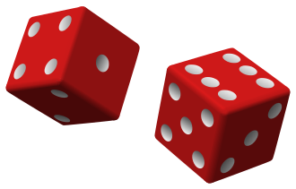
Random Number Generator
In the common parlance, Randomness is the apparent lack of pattern or predictability in events.
A Random Number Generator (RNG) is a device that generates a sequence of numbers or symbols that cannot be reasonably predicted better than by a random chance. Random number generators can be true Hardware Random-Number Generators (HRNG), which generate genuinely random numbers.

Slide 3
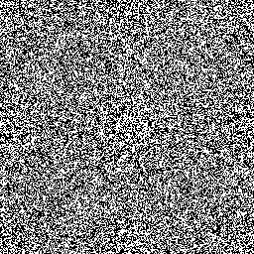
Pseudo Random Number Generator
A pseudorandom number generator (PRNG) is also known as a deterministic random bit generator.
It is an algorithm for generating a sequence of numbers whose properties approximate the properties of sequences of random numbers.
The PRNG-generated sequence is not truly random, because it is completely determined by an initial value, called the PRNG's seed.

Slide 4

Cryptography
Cryptography or cryptology is about constructing and analyzing protocols that prevent third parties or the public from reading private messages.
In Cryptography, Encryption is the process of encoding a message or information in such a way that only authorized parties can access it and those who are not authorized cannot.

Slide 5
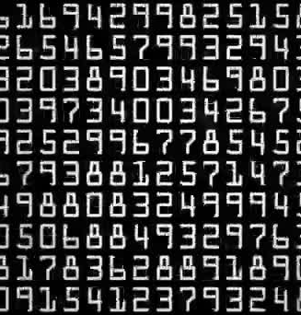
Cryptographically secure Pseudorandom number generator
A cryptographically secure pseudorandom number generator (CSPRNG) is a pseudorandom number generator (PRNG) with properties that make it suitable for use in cryptography.
Most cryptographic applications require random numbers.
The "quality" of the randomness required for these applications varies.

Slide 6

Tests to prove the randomness of numbers
Distribution of Random Numbers
Distribution of Random Number pairs
Distribution of Gaps(Gap test)
Chi square of Gaps for all 256
Run test Distribution
Position of Random Number pairs
Kolgomorow Complexity
Kolgomorow Complexity Bar
3-Max Test
4-Max Test
7-Max Test

Slide 7
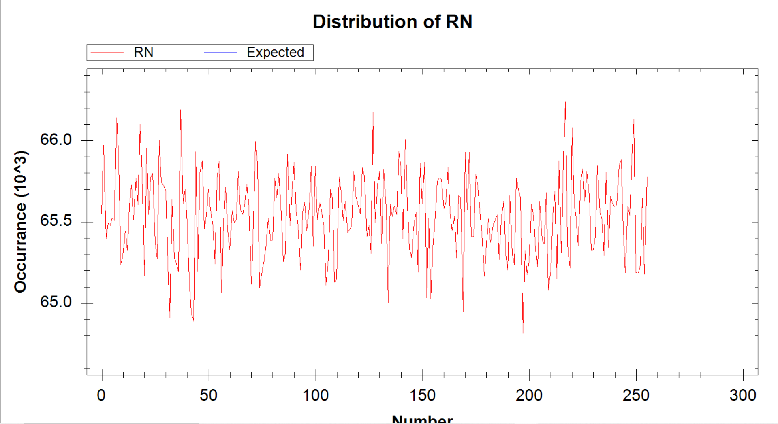
Distribution of Random Numbers
In this test we can see the distribution of random numbers on a graph which involves Occurrence v/s Number.
The theoretical values in this graph is represented with the blue straight line.
The practical values are represented with the red line and the line should be scattered which represents the randomness.

Slide 8
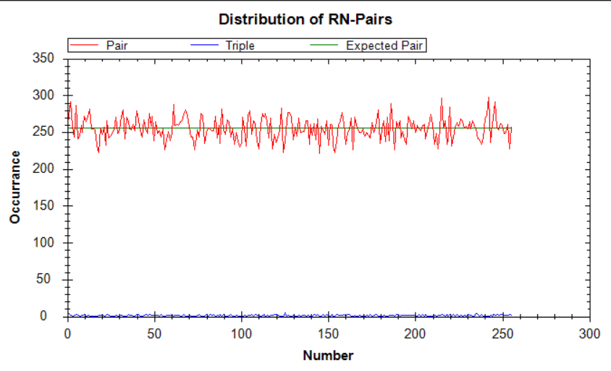
Distribution of Random Number pairs
This graph represents the distribution of Random number pairs in the given random numbers.
It also uses the same variables like Occurrence v/s Number.
This graph can also be used to represent the triples in the given random numbers.

Slide 9
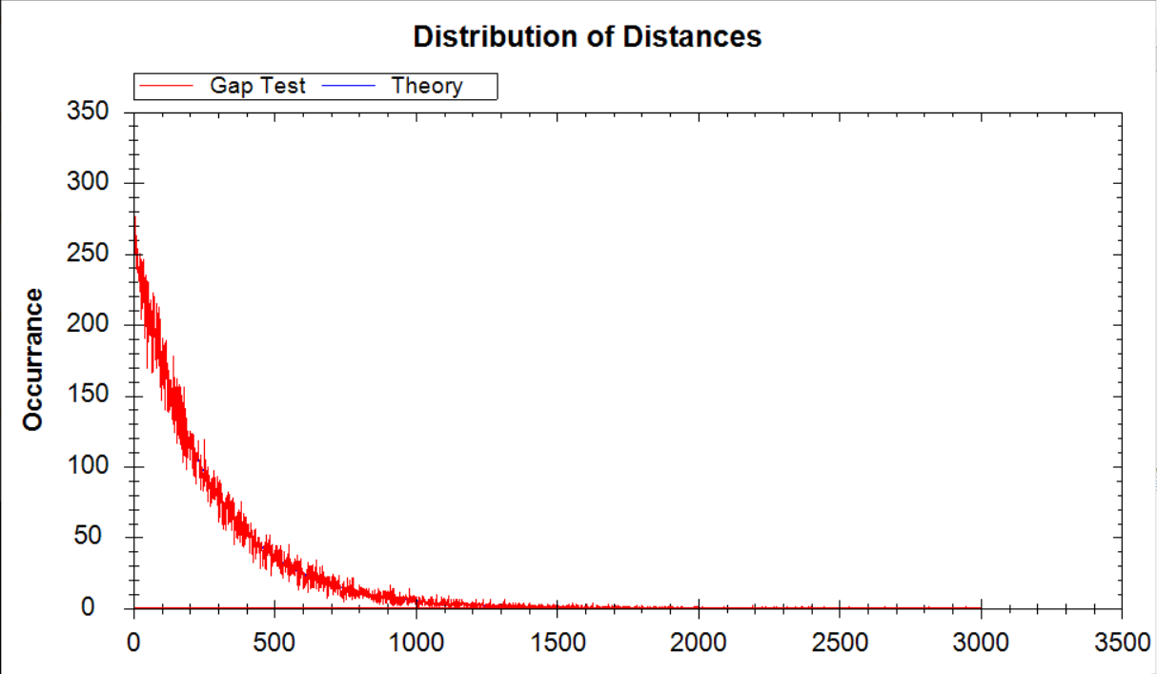
Distribution of Gaps(Gap test)
The gap test is used to determine the significance of the interval between recurrence of the same digit.
A gap of length x occurs between the recurrence of some digit.
Notes:
The gap test is used to determine the significance of the interval between recurrence of the same digit.
A gap of length x occurs between the recurrence of some digit.

Slide 10
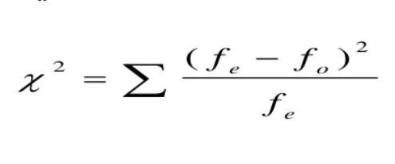
Chi square test
The Chi-square test is intended to test how likely it is that an observed distribution is due to chance. It is also called a "goodness of fit" statistic, because it measures how well the observed distribution of data fits with the distribution that is expected if the variables are independent.
It is the most sensitive test.
If we change the random number sequence input, we can observe the change in the chi square values.

Slide 11
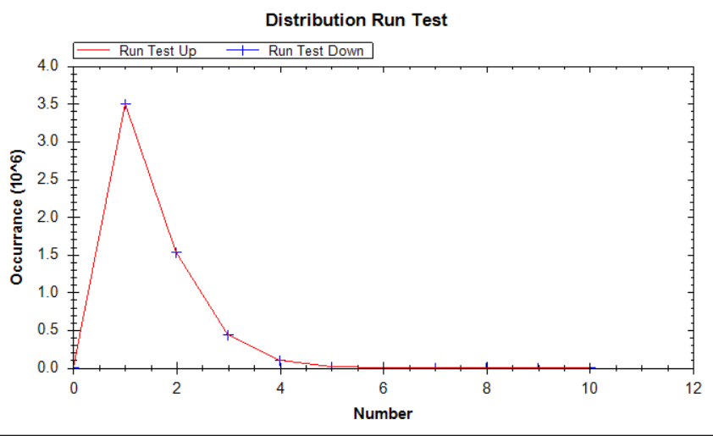
Run test Distribution
A runs-test is a statistical procedure that examines whether a string of data is occurring randomly from a specific distribution. The runs test analyzes the occurrence of similar events that are separated by events that are different.
Running a test for randomness is carried out in a random model in which the observations vary around a constant mean.

Slide 12
Results

Slide 13
System Generated Random Numbers without using clock
Random Numbers filled = 16777216
Statistic Calculations finished
Normalized Chi Square = 1.01090979576111
Normalized Chi Square_Pair = 1.02687072753906
Normalized Chi Square_Triple = 1.1875
Normalized Chi Square_Distance = 1.04601976317021
Runs Test -->
Runs Up = 5580602
Runs Down = 5580601
All Runs = 11161203
Mean Runs Theory = 11184810.3333333
Variance = 2982615.85555556
Deviation in % = 0.211066013904399
Variance in % = 26.666664580504
Chi_Kolgomorow = 1.00680231515875
Chi Square 3 Max = 1.14034308745173
Chi Square 4 Max = 0.992681886763068
Chi Square 7 Max = 1.05560184196347

Slide 14
System Generated Random Numbers with using clock
Random Numbers filled = 16777216
Statistic Calculations finished
Normalized Chi Square = 16693770.8012853
Normalized Chi Square_Pair = 255.695938110352
Normalized Chi Square_Triple = 1
Normalized Chi Square_Distance = 40.9584064006916
Runs Test -->
Runs Up = 2993
Runs Down = 2992
All Runs = 5985
Mean Runs Theory = 11184810.3333333
Variance = 2982615.85555556
Deviation in % = 99.9464899285582
Variance in % = 26.666664580504
Chi_Kolgomorow = 1596.67307542003
Chi Square 3 Max = 122036972723.045
Chi Square 4 Max = 68645784839.5016
Chi Square 7 Max = 22414946116.7651

Slide 15
Dividing the Obtained random numbers file into half and replacing second half with the first
Random Numbers filled = 16777216
Statistic Calculations finished
Normalized Chi Square = 1.62174570560455
Normalized Chi Square_Pair = 1.85296630859375
Normalized Chi Square_Triple = 2
Normalized Chi Square_Distance = 2.07377128636134
Runs Test -->
Runs Up = 5581458
Runs Down = 5581458
All Runs = 11162916
Mean Runs Theory = 11184810.3333333
Variance = 2982615.85555556
Deviation in % = 0.195750599972927
Variance in % = 26.666664580504
Chi_Kolgomorow = 1.73510582130201
Chi Square 3 Max = 1.58439175386527
Chi Square 4 Max = 1.99178608807614
Chi Square 7 Max = 1.39340243890736

Slide 16
Generated Random numbers using the C# function ‘System.Security.Cryptography;’
Random Numbers filled = 16777216
Statistic Calculations finished
Normalized Chi Square = 1.03689908981323
Normalized Chi Square_Pair = 1.054931640625
Normalized Chi Square_Triple = 1.15234375
Normalized Chi Square_Distance = 0.990206361481586
Runs Test -->
Runs Up = 5580626
Runs Down = 5580625
All Runs = 11161251
Mean Runs Theory = 11184810.3333333
Variance = 2982615.85555556
Deviation in % = 0.210636860449226
Variance in % = 26.666664580504
Chi_Kolgomorow = 1.11396992925287
Chi Square 3 Max = 1.21250956225624
Chi Square 4 Max = 1.19289542997033
Chi Square 7 Max = 1.16235963158786

Slide 17
Applications
Generating keys for encrypting and decrypting in cryptography.
Gambling
Statistical sampling
Simulation and modeling applications
Other areas where producing an unpredictable result is desirable.

Slide 18

Conclusion
For cryptography, the random number generator is very much important and in many aspects like generating the key very securely.
To obtain the Cryptographically secure Pseudorandom number generator the random number generator should pass all the above mentioned test.
After looking at the test results, we can say that the random numbers generated using the C# function System.Security.Cryptography; we can say that this might be the best method to generate the random numbers.

Slide 19
References
https://en.wikipedia.org/wiki/Randomness_tests
https://www.cse.wustl.edu/~jain/cse567-08/ftp/k_27trg.pdf
https://www.eg.bucknell.edu/~xmeng/Course/CS6337/Note/master/node42.html
https://www.digit.in/technology-guides/fasttrack-to-cryptography/uses-of-cryptography.html
en.wikipedia.org/wiki/Applications_of_randomness
https://en.wikipedia.org/wiki/Pseudorandom_number_generator

Slide 20
Thank you

